Slide 1

Computer Vision Applications
By Quadeer Shaikh

Slide 2

About me
Work Experience
Risk Analyst
Morgan Stanley (Jan 2023 – Present)
Data Science Intern
AkzoNobel Coatings International B.V. Netherlands (Feb 2022 – Dec 2022)
Data Science Intern
EzeRx Health Tech Pvt. Ltd. (Jan 2022 – July 2022)
Associate Engineer
Tata Communications Ltd. (July 2019 – Aug 2020)
Network Automation and Analysis Engineer Intern
Cisco (June 2018 – July 2018)
Education
M.Tech – Artificial Intelligence
NMIMS (2021 - 2023, currently pursuing)
B.E. – Computer Engineering
Mumbai University (2015 - 2019)

Slide 3

Object Detection

Slide 4
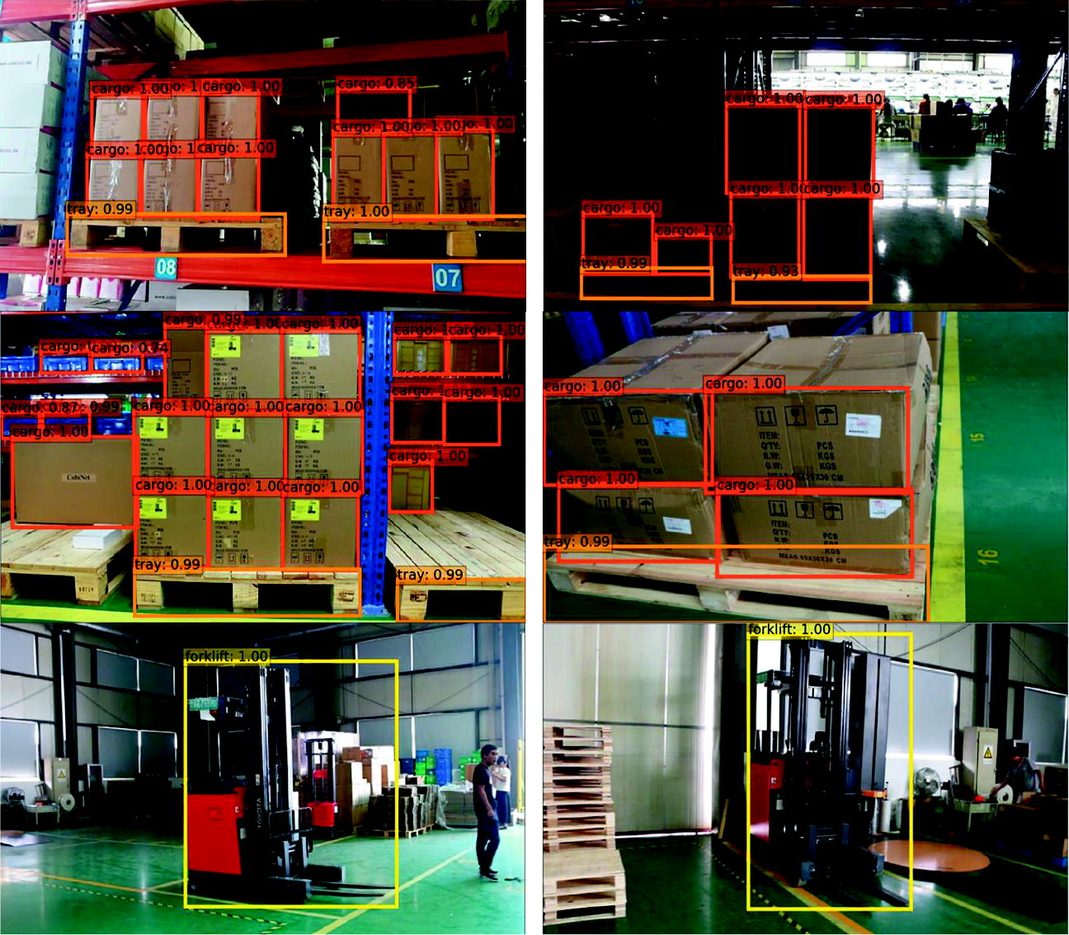
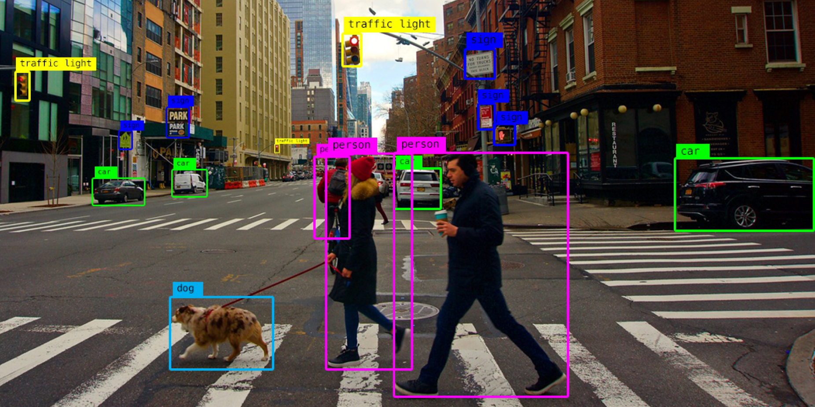
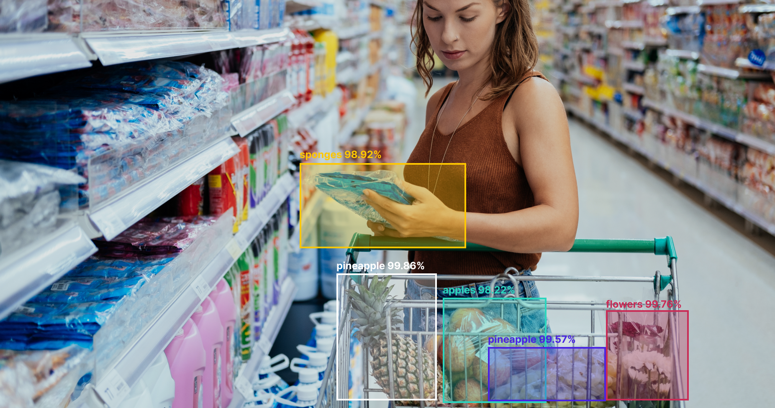
What is object detection ?
Object detection is a computer technology related to computer vision and image processing that deals with detecting instances of semantic objects of a certain class in digital images and videos.
It is a computer vision technique for locating instances of objects in images or videos. Object detection algorithms typically leverage machine learning or deep learning to produce meaningful results.
17 interesting applications: https://alwaysai.co/blog/object-detection-for-businesses

Slide 5
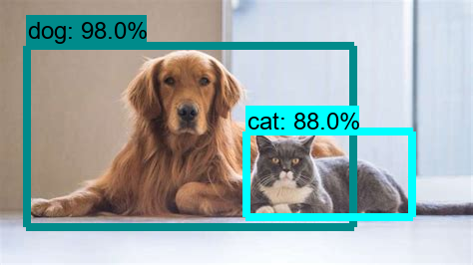
How do you localize an object in an image ?
Ermm….. Maybe we can plot a rectangle that bounds an object of interest ? And hence, Bounding Box
We know how to predict a class of an image, but how do we go about predicting a bounding box ?
How do we create a rectangle/bounding box in computer vision using tools like opencv at all ?

Slide 6
Bounding Box Regression
Syntax: cv2.rectangle(image, start_point, end_point, color, thickness)
Where, start_point = (xmin, ymin) and end_point = (xmax, ymax)
So we perform a regression task to predict 4 values of 2 pairs of coordinates
xmin, ymin, xmax, ymax

Slide 7
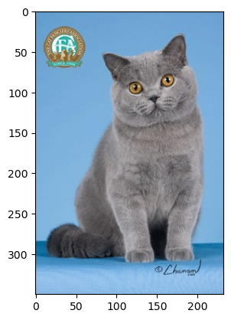
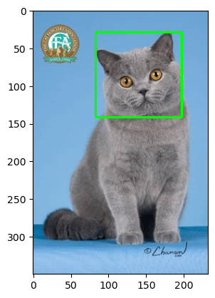
Bounding Box Regression
Example: This is an image of Sir. Jim Radicliffe, a British Shorthair
Image Dimensions: Height is 350, Width is 233, Colored image so Depth is 3
Rectangle Coords: 83,29,197,142

Slide 8
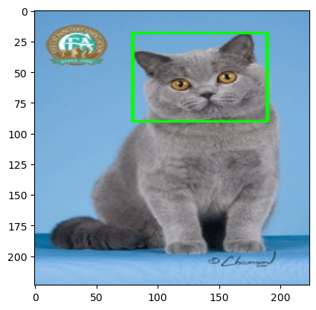
Bounding Box Regression
But don’t we feed a fixed size image input to our CNNs ? Maybe something like 224x224x3
Example: This is an image of Sir. Jim Radicliffe, a British Shorthair
Image Dimensions: Height is 350, Width is 233, Colored image so Depth is 3
Rectangle Coords: 83,29,197,142
That is why we normalize the coordinates
xmin: 83/233 (xmin/width)
ymin: 29/350 (ymin/height)
xmax: 197/233 (xmax/width)
ymax: 142/350 (ymax/height)
If we resize the above image to 224x224x3
xmin = int(xmin*224)
ymin = int(ymin*224)
xmax = int(xmax*224)
ymax = int(ymax*224)

Slide 9
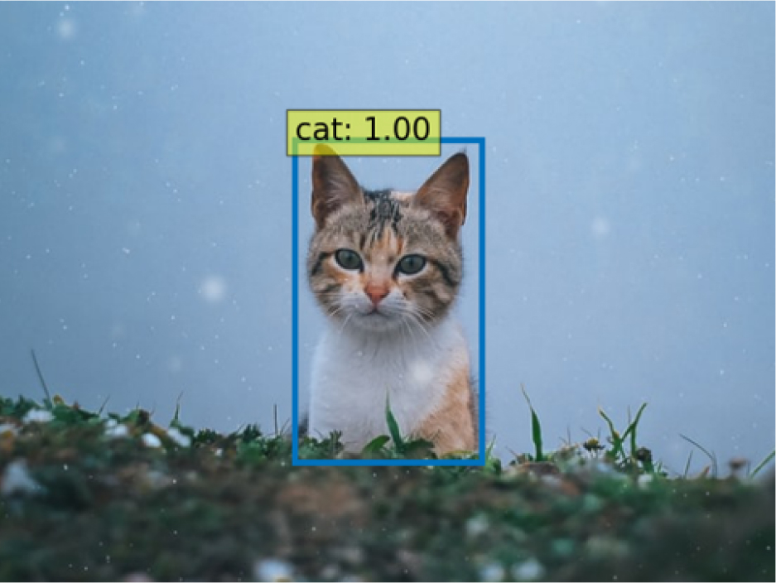
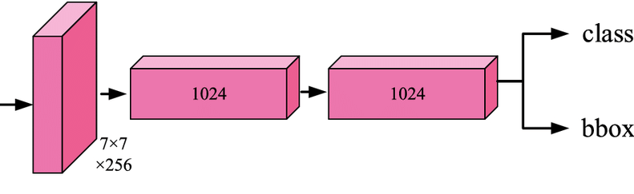
Classification with Bounding Box Regression
Class predictor maybe a sigmoid or a softmax depending on the number of class of objects that we are predicting

Slide 10
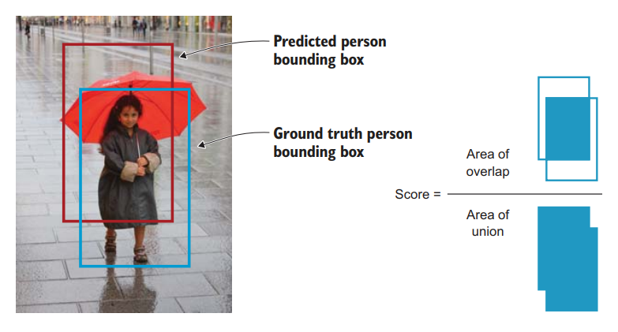
How to assess the prediction of Bbox ?
Intersection over Union
This measure evaluates the overlap between two bounding boxes: the ground truth bounding box (Bground truth) and the predicted bounding box (Bpredicted). By applying the IoU, we can tell whether a detection is valid (True Positive) or not (False Positive)

Slide 11
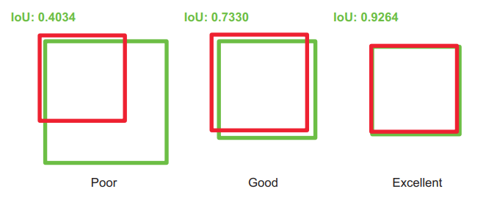
How to assess the prediction of Bbox ?
Intersection over Union
The intersection over the union value ranges from 0 (no overlap at all) to 1 (the two bounding boxes overlap each other 100%). The higher the overlap between the two bounding boxes (IoU value).

Slide 12
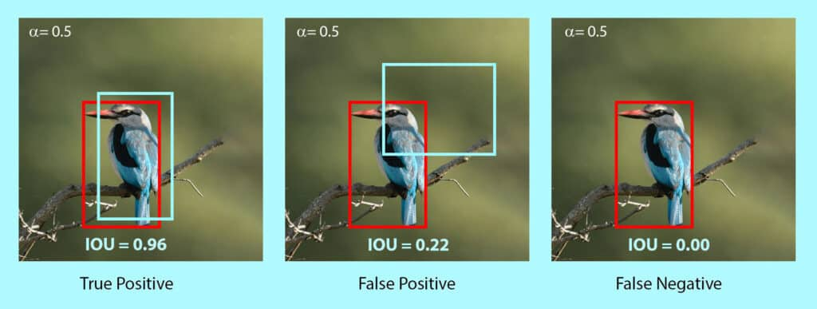
Confusion Matrix for IoU
Note: True Negative is not applicable to object detection. True Negative means it is correctly detecting the background of an object as background. Which is equivalent to not detecting anything.

Slide 13
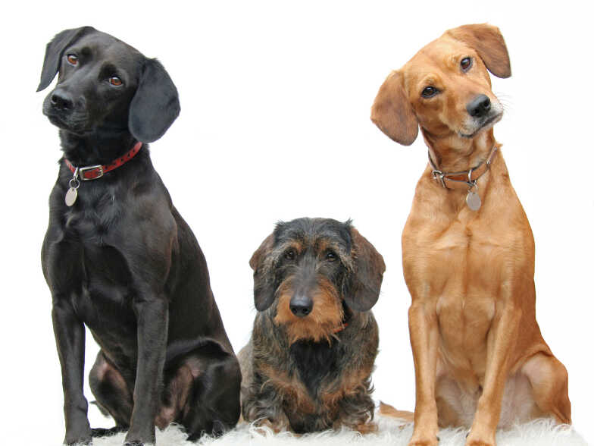
Is object detection really that simple ?
Bounding box regression with classification module works out fine if you have just one object in an image and you want to detect one object
If you have multiple objects of a similar class in an image it will only detect one of them which it is most confident about
How do we address this issue ?
Hemk 2 big doggos, but lil nugget gets detected
Wut the floof I is a doggo too
Doggo

Slide 14

Take a trip down the memory lane
What did we stumble upon in our fundamental computer vision modules that could help us find the objects of interest ?

Slide 15
Take a trip down the memory lane
What did we stumble upon in our fundamental computer vision modules that could help us find the objects of interest ?
Objects of interest…….mmm….. Regions of Interest (ROI) ?!

Slide 16
Region based CNN Models
RCNN (2013)
Fast RCNN (2015)
Faster RCNN (2015)

Slide 17
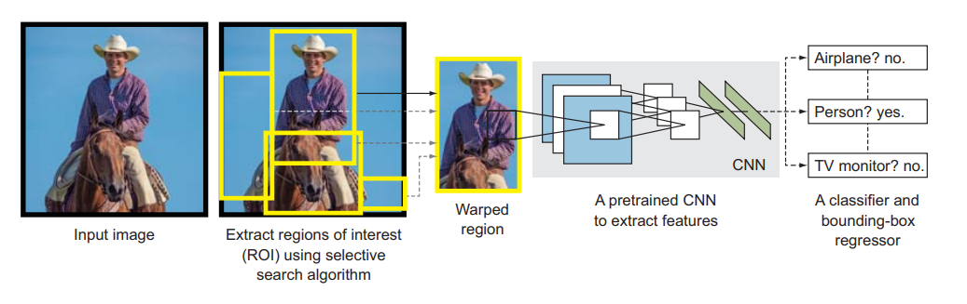
RCNN
It is the first region based architecture in the region proposal based object detection family
It was one of the first large, successful applications of convolutional neural networks to the problem of object detection and localization
The approach was demonstrated on benchmark datasets, achieving then-state-of-the-art results on the PASCAL VOC-2012 dataset and the ILSVRC 2013 object detection challenge

Slide 18
RCNN Components
Region Proposal: Extract Regions of Interest (ROI)
Feature Extraction Module
Classification Module
Localization Refinement Module (optional component)

Slide 19
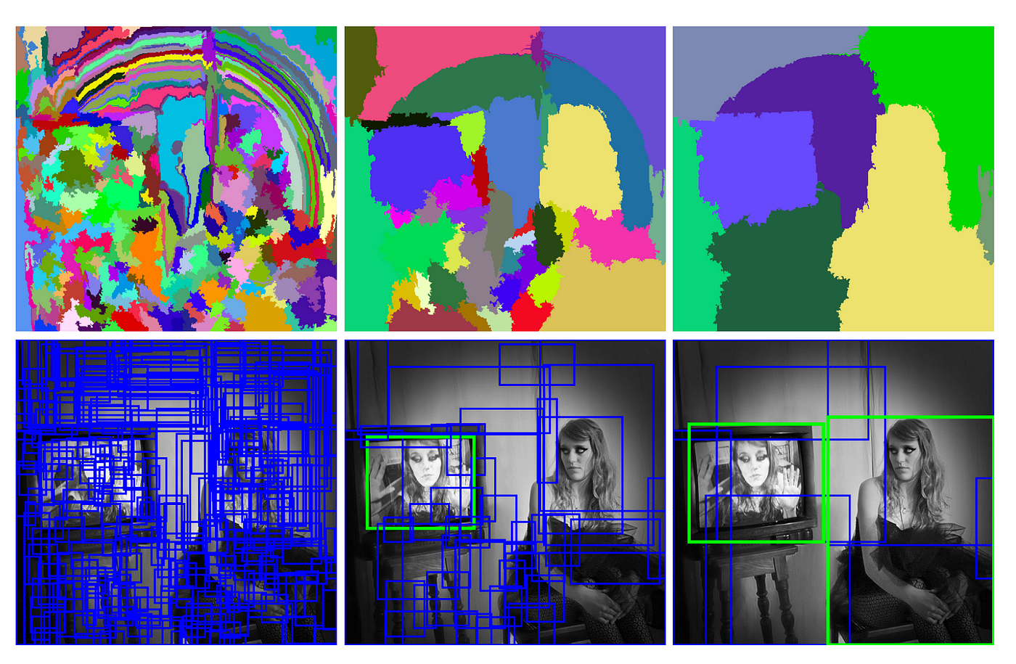
RCNN – Region Proposal
The regions proposed in this step have a very high probability of containing an object
An algorithm called selective search scans the input image to find regions that contain blobs and proposes RoIs (2000 RoIs in fast mode, approx. 9000 in regular mode) to be processed by the next components of the RCNN.
The proposed RoIs are of different sizes
But since a CNN is fed an image of fixed size we warp the RoIs to a fixed size
Note: Since the selective search algorithm proposes region proposal bounding boxes, bounding box regression becomes an optional component

Slide 20
RCNN – Feature Extraction
We run a pretrained CNN (on imagenet) on top of the region proposals to extract features from each of these candidates
However, since the proposed regions vary in size and are typically warped to fixed size, an imagenet pretrained CNN’s feature extraction offers a mediocre/poor performance
Therefore, the pretrained network is finetuned on the warped region proposals using the softmax classification output layer
AlexNet/VGG-Net (initial version of VGG-16/19) was used as a pretrained network

Slide 21
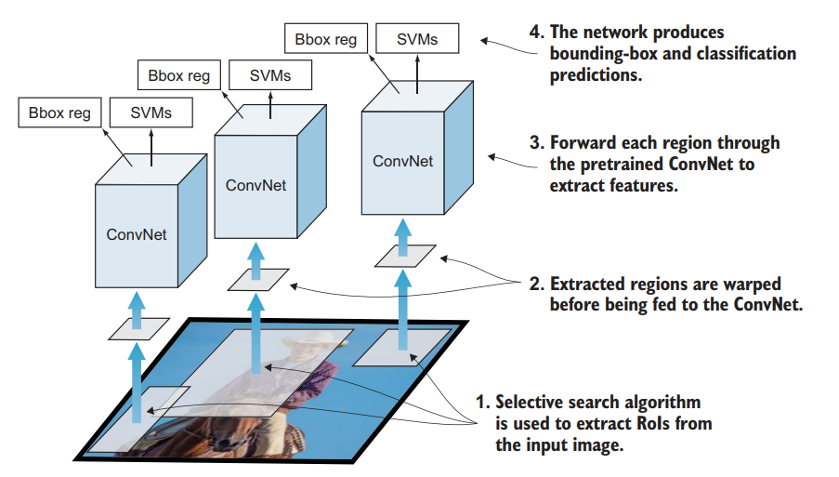
RCNN – Classification Module & Bbox Refinement
We train a Linear SVM to perform classification on the features extracted using the pretrained network on the candidate region proposals
Linear SVM performs a one vs rest classification to classify an object into a particular class
Since Selective Search takes care of the localization using its own proposed regions bounding box we do not explicitly perform the bounding box regression step
But to improve the localization step further we include the bounding box regression to give more refined coordinates of the bounding box

Slide 22
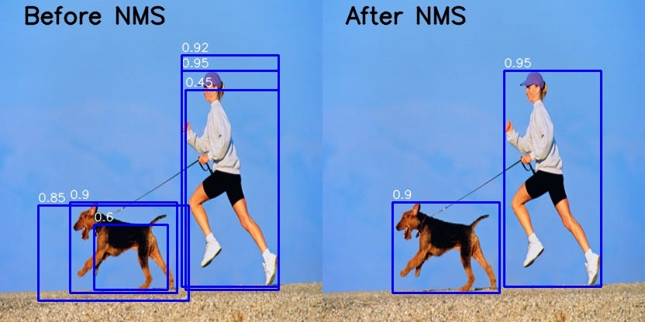
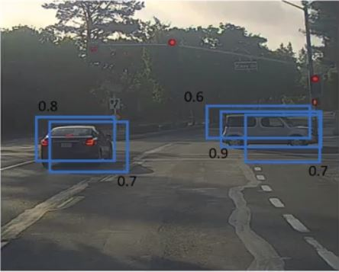
Multiple Bbox single object: NMS
Non max suppression is a technique used mainly in object detection that aims at selecting the best bounding box out of a set of overlapping boxes
Sort the bboxes in descending order of class confidence/probability score
remove the boxex which have a confidence score < threshold confidence score (e.g. remove boxes with score < 0.5)
Loop over the remaining boxes
Start with the box which has the highest confidence
Discard other boxes if they have an IoU > predefined IoU thresh with the highest confidence box
Repeat the steps until all the boxes are either taken as output prediction or discarded

Slide 23
Multiple Bbox single object: NMS

Slide 24
Disadvantages of RCNN
Object Detection is very slow
For each image selective search proposes 2000 RoIs to be examined by the entire pipeline. These 2000 RoIs are then passed on to the CNN 2000 times for a single image i.e. 2000 forward propagations for a single image. This process makes it computationally very expensive. During inference object detection in a single image takes 50 seconds (47.5 seconds for CNN + time taken for selective search)
Multiple Training stages (3 stages)
Finetuning of CNN feature extraction
Training of object classes using SVMs
Training of Bbox regressors for bounding box refinement
Two stage pipeline
First stage is for Region Proposals
Second stage is for Object Detection on Region Proposals
Training is expensive in terms of both time and space
2000 RoIs per image need to finetuned
2000 RoIs per image need to be stored on the disk

Slide 25
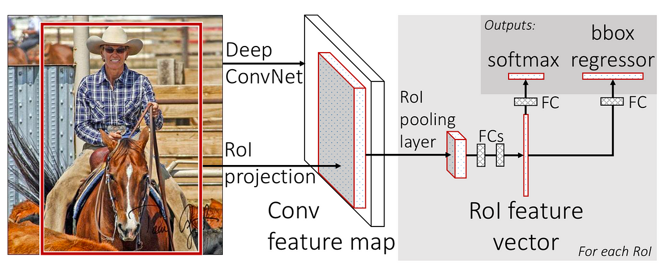
Fast RCNN (Inspired by SPPNet: Spatial Pyramid Pooling Network)
Since feeding 2000 RoIs to the CNNs 2000 times for a single image was a bad idea the author of the paper on RCNN came up with a new architecture
Bounding box coordinate format: (x_c, y_c, w, h)
x_c – x center, y_c – y center, w – width, h - height

Slide 26
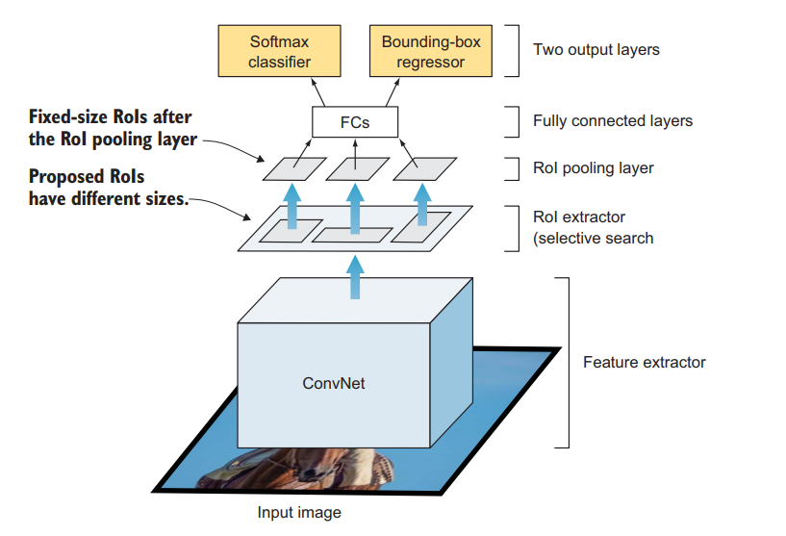
Fast RCNN
Pass the input image to the feature extractor just once
Pass the input image to selective search algorithm to get RoIs/Region Proposals
Feature maps are produced by the pooling layer of the pretrained network
RoIs from step 2 are projected onto the feature maps
RoI pooling is performed on the projected RoIs
RoI pooling output is passed to the fully connected layers
Fully connected layer is connected to the multi-head output
Classifier
Bbox Regressor

Slide 27

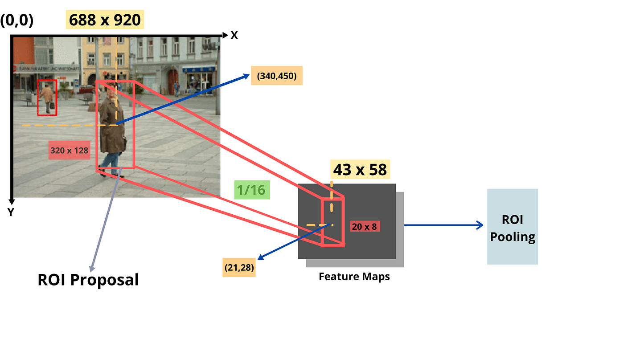
RoI Projection
The final max pooling layer produces a feature map of size 7x7x512
An image of size 224x224 gets downsampled to 7x7, therefore we can calculate its subsampling ratio by 224/7 = 32
Any object that is present in the image of size 224x224 can be projected to the feature map of size 7x7 if we divide the height and width of that object by 32.

Slide 28
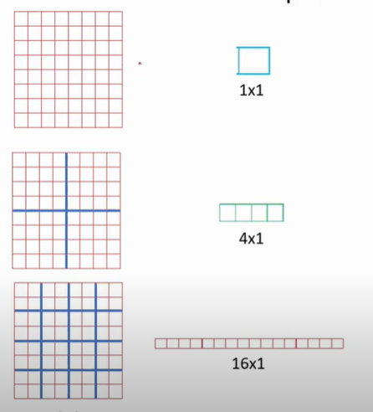
ROI Pooling
The projected RoIs on the feature maps are then pooled and passed on to the fully connected layers
But since the projected RoIs will vary in size we need to do something about it
We perform a special type of pooling known as ROI pooling.
ROI pooling takes the max value from each grid
We use a 7x7 grid to perform ROI pooling on a feature map which will produce a vector of size 49x1
1x1 grid ROI pooling will produce 1x1 vector
2x2 grid will produce a 4x1 vector
4x4 grid will produce a 16x1 vector

Slide 29
Classification and Bbox Regression Module
Classification: Softmax classifier is used for classification prediction
Bbox Regression: Offsets between the selective search region proposals and ground truth bounding boxes are predicted for each class (this method is known as Relative Bounding Box Regression)
tx = x_center_gt – x_center_ss
ty = y_center_gt – y_center_ss
tw = w_gt – w_ss
th = h_gt – h_ss

Slide 31
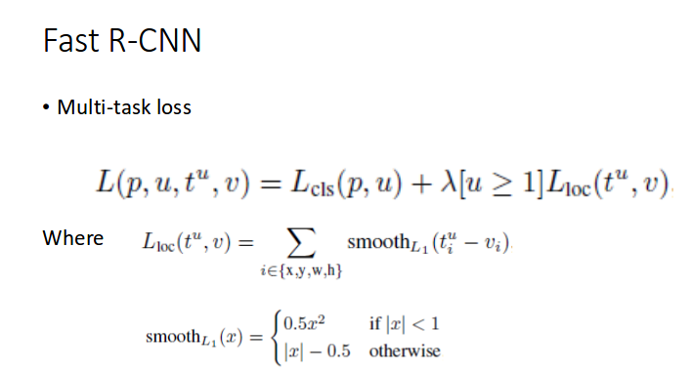
Loss function

Slide 32
Advantages and Disadvantages of Fast RCNN
Advantages
Disadvantages
Requires only one propagation for each image unlike 2000 in RCNN
Three stage training from RCNN reduced to one stage training
Faster in inference time than RCNN: 2 seconds (0.32 seconds for CNN + time required for selective search)
It is still a two stage pipeline
Selective Search Region Proposal
CNN
Selective search still remains to be a bottleneck as it is very slow to generate region proposals. 2 seconds of inference time is too much for real time object detection in videos.

Slide 33
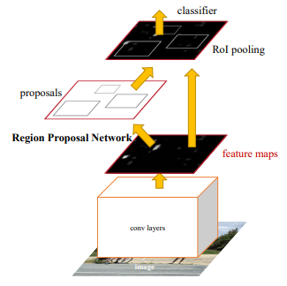
Faster RCNN
We now know that the major bottleneck with region based CNNs till now is the traditional and slow region proposal method (selective search)
We need to replace the selective search method with some other region proposal method based on the following criteria
< 2000 region proposals
As fast as SS or better
As accurate as SS or better
Should be able to propose overlapping ROIs with different aspect ratios and scales

Slide 34
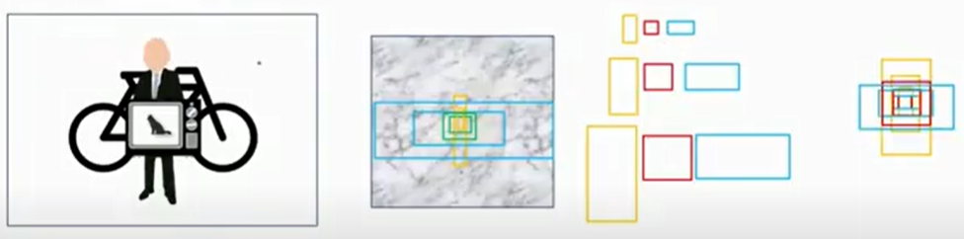
Faster RCNN: Region Proposal Aspect Ratios
To detect most kinds of objects you typically use one of the 3 aspect ratios given below
Vertical rectangle
Square
Horizontal rectangle
Most of the object will be obstructing the one behind and hence you need overlapping ROIs
Objects maybe of different size therefore you need ROIs of different scale

Slide 35
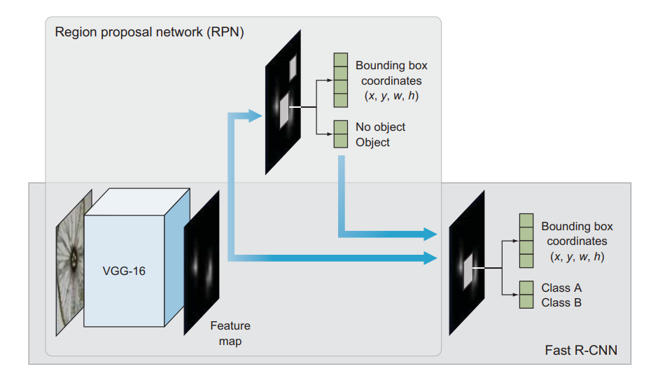
Faster RCNN: Components
To address the constraint of selective search for region proposals we have the following addition in Faster RCNN
Region Proposal Network (RPN): Selective Search is replaced by a ConvNet that proposes RoIs from the last feature maps of the feature extractor that are considered for investigating objects of interest. RPN has two outputs
Objectness Score: whether there is an object present (1) or absent(0)
Box location
Fast RCNN: same components
Base network for feature extraction
RoI pooling layer
Output layer that contains two fully connected layers: softmax classifier and bounding box regression

Slide 36
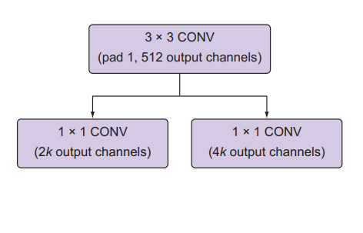
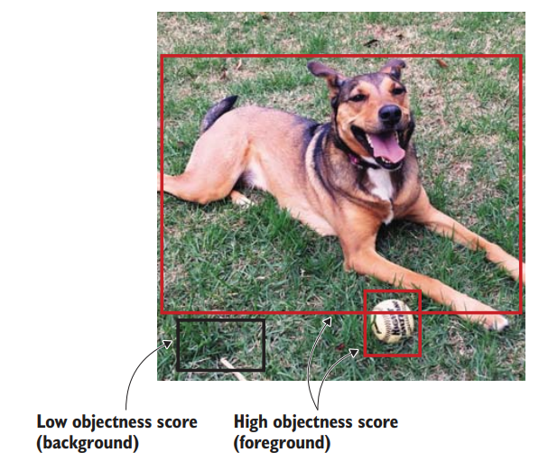
Region Proposal Network (RPN)
RPN identifies RoIs based on the last feature map of the pretrained CNN. Faster RCNN uses RPN to perform the region proposals instead of using selective search like its earlier versions
The architecture of RPN is composed of two layers
A 3x3 conv layer with 512 filters
Two parallel 1x1 conv layers
Classification layer: Predicts whether the is an object present in the proposed region (or just random background
Bounding box regression layer: bounding box of proposed RoIs
Note: Remember that RPN is not doing object detection but it is only finding objects of interest that the later components can both localize and classify

Slide 37
How are the region proposed bounding boxes predicted ?
Bounding box can be defined as (x,y,w,h) where x and y are the centers of the bounding box and w and h are the widths and heights respectively
We perform relative bounding box regression i.e. we create reference boxes called as anchor boxes in the image and make the regression layer predict the offsets from these boxes called deltas (Δx, Δy, Δw, Δh) to adjust the anchor boxes to better fit the object to get final proposals

Slide 38
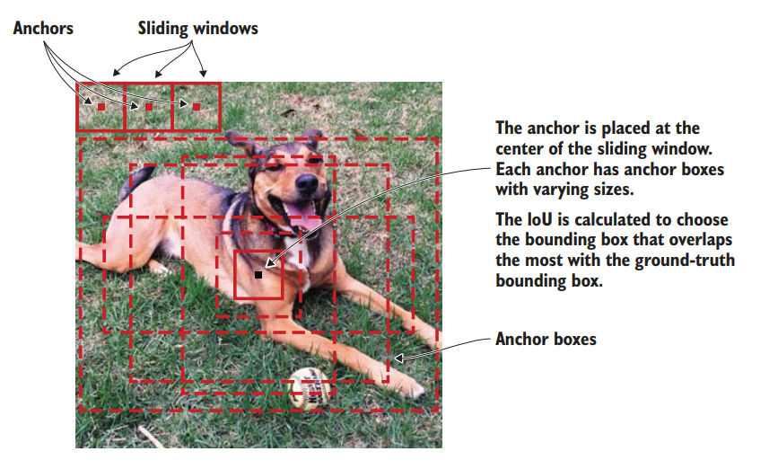
Anchor Boxes
RPN generates k RoIs for each location in the feature map using a sliding window approach. These regions are represented using anchor boxes.
The anchors are centered in the middle of their corresponding sliding window and are of different aspect ratios and scales to cover a wide variety of different sized objects
They are fixed bounding boxes that are placed throughout the image to be used for reference when first predicting the region proposals for objects of interest
In the Faster RCNN paper, anchor boxes with 3 different aspect ratios and 3 different scales were proposed

Slide 39
Training the RPN: Need to ensure there are less than 2000 RoIS
RPN is used to classify whether an object is present or not and propose the bounding box for an object
How does one prepare the data for whether there is an object present or not inside the anchor box ?
For each anchor the overlap value is computed which indicates how much these anchor boxes overlap with the ground truth boxes (or how useful these anchor boxes are going to be to help us find the region proposals)
Only the following anchor inputs are taken forward for the objectness classification
Anchor boxes having high IoU with ground truth boxes IoU > 0.7 (positive anchor boxes)
Anchor boxes having low IoU with ground truth boxes IoU < 0.3 (negative anchor boxes)
Rest of the anchor boxes are ignored 0.3< IoU <0.7

Slide 40
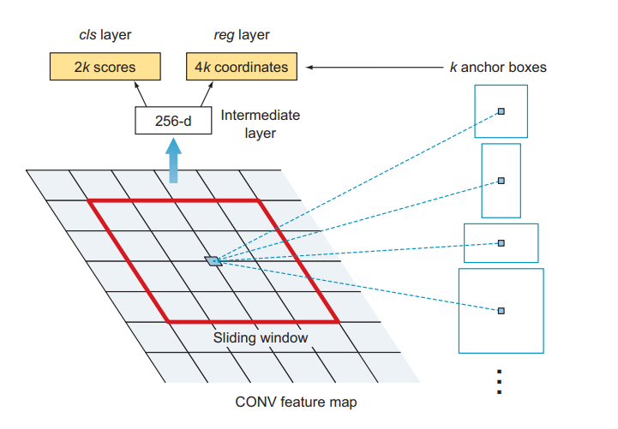
Training the RPN Contd.
During the training process the positive and negative anchors are passed as input to two fully connected layers corresponding to the classification of anchors as containing an object or no object, and to the regression of location parameters (four coordinates)
Corresponding to the k number of anchors from a location, the RPN network outputs 2k scores and 4k coordinates. Thus, for example, if the number of anchors per sliding window (k) is 9, then the RPN outputs 18 objectness scores and 36 location coordinates

Slide 41
Training the Fast RCNN component of Faster RCNN
The final fully connected layers of the network take two inputs:
Feature maps from the feature extractor
RoIs coming from the RPN
The RoIs are projected on to the feature maps in the same way like Fast RCNN
Softmax Classifier and Bounding Box regressor are used to predict the object class and bounding box offsets respectively for the detected object

Slide 42
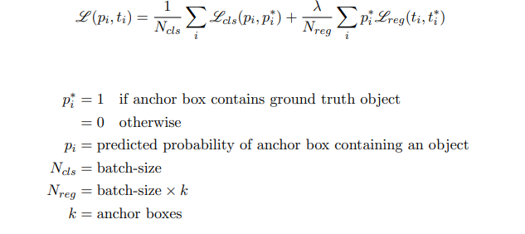
RPN: Loss Function

Slide 43
Faster RCNN Training in a Nutshell
Finetune RPN using a pretrained network
Finetune Fast RCNN using a pretrained network on the proposed images from step 1
Finetune RPN using the pretrained network used in step 2
Now finetune the Fast RCNN using the pretrained network used in step 3 on the images proposed in step 3

Slide 44
Review of RCNN Family
mAP on Pascal VOC 2007
RCNN: 66%
Fast RCNN: 66.9%
Faster RCNN: 66.9%
Limitations
RCNN: 3 stage training, high computation time and memory requirements
Fast RCNN: Selective search is slow and hence computation time is still high
Faster RCNN: It is still a 2 stage network
Test Time Per Image
RCNN: 50 seconds
Fast RCNN: 2 seconds
Faster RCNN: 0.2 seconds
Speedup from RCNN
Fast RCNN: 25x
Faster RCNN: 250x

Slide 45
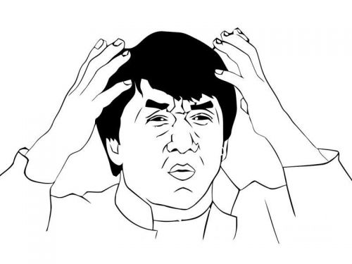
mAP: mean Average Precision
Mean Average Precision (mAP) is a performance metric popularly used for object detection models. It is the most popular metric that is used by benchmark challenges for object detection such as PASCAL VOC, COCO, ImageNET challenge, Google Open Image Challenge, etc.
Is it just average of precisions ? Its not that simple.

Slide 46
mAP: mean Average Precision
Remember IoU ?

Slide 47
mAP: mean Average Precision
Remember Precision ?
Precision measures the proportion of predicted positives that are actually correct. If you are wondering how to calculate precision, it is simply the True Positives out of total detections. Mathematically, it’s defined as follows.
P = TP/(TP + FP)
= TP / Total True Predicted
The value ranges from 0 to 1.

Slide 48
mAP: mean Average Precision
Remember Recall ?
Recall measures the proportion of actual positives that were predicted correctly. It is the True Positives out of all Ground Truths. Mathematically, it is defined as follows.
R = TP / (TP + FN)
= TP / Total Ground Truths
Similar to Precision, the value of Recall also ranges from 0 to 1.

Slide 49
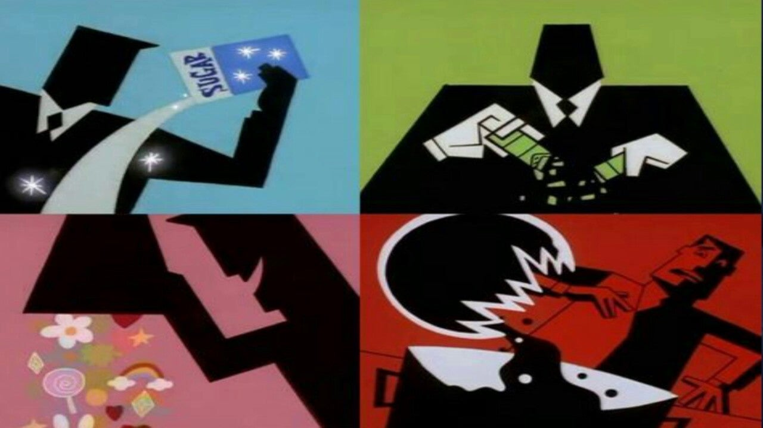
mAP: mean Average Precision
IoU
Precision
mAP
Recall

Slide 50
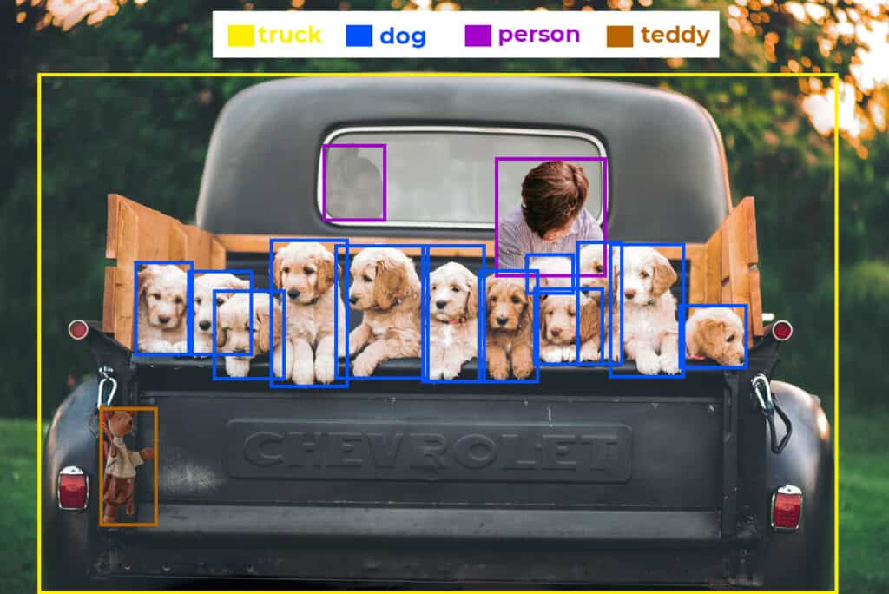
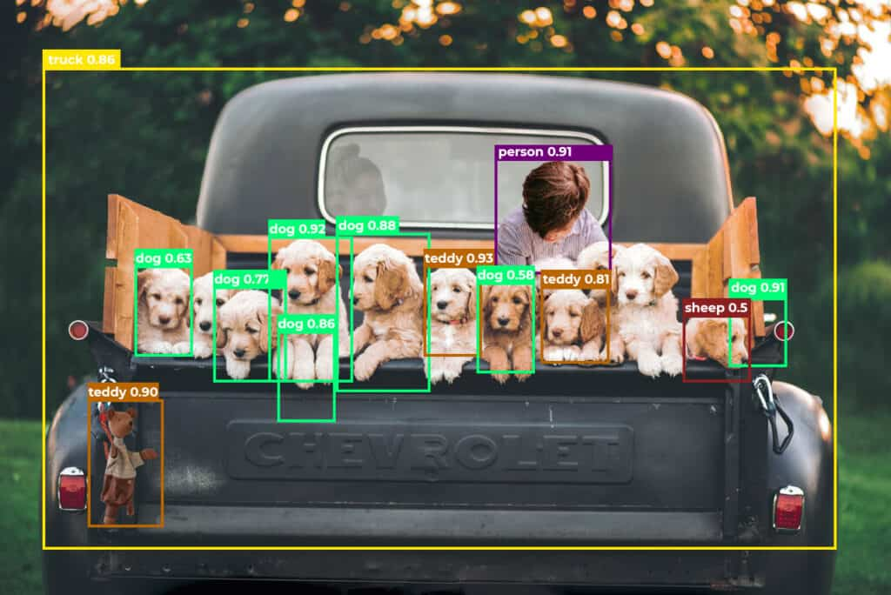
mAP: mean Average Precision
Average Precision (AP) is actually not the average of Precision (P). The term AP has evolved with time. For simplicity, we can say that it is the area under the precision-recall curve.

Slide 51
mAP: mean Average Precision
There are 12 dogs, 2 persons, 1 teddy and 1 truck. The predictions are 7 dogs, 1 person, 3 teddies and 1 truck.

Slide 52
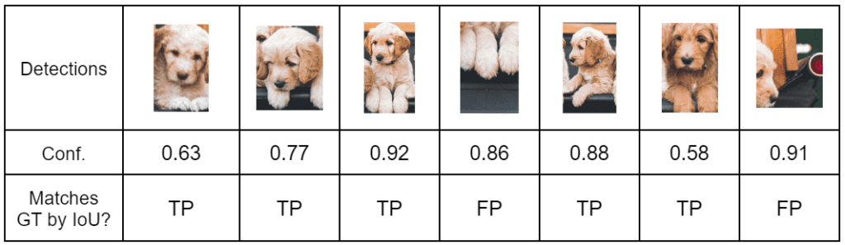
AP: for class Dog

Slide 53
mAP: mean Average Precision
** space for lethal math **

Slide 54
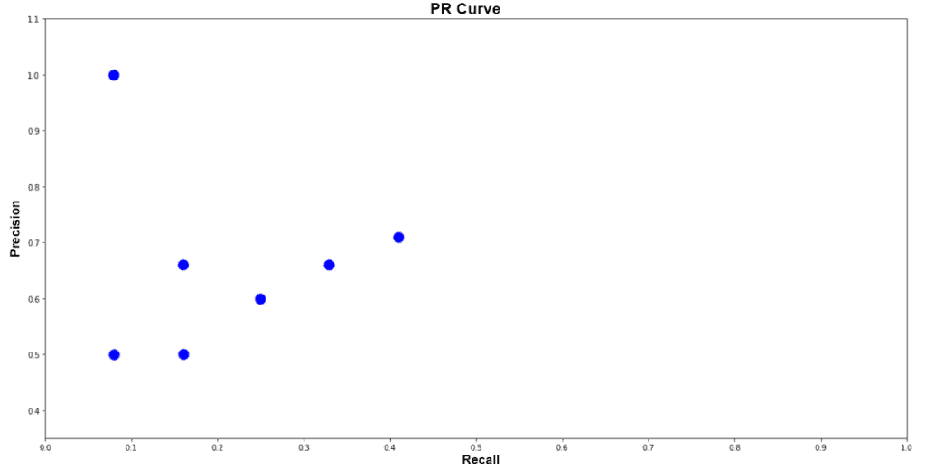
mAP: PR curve

Slide 55
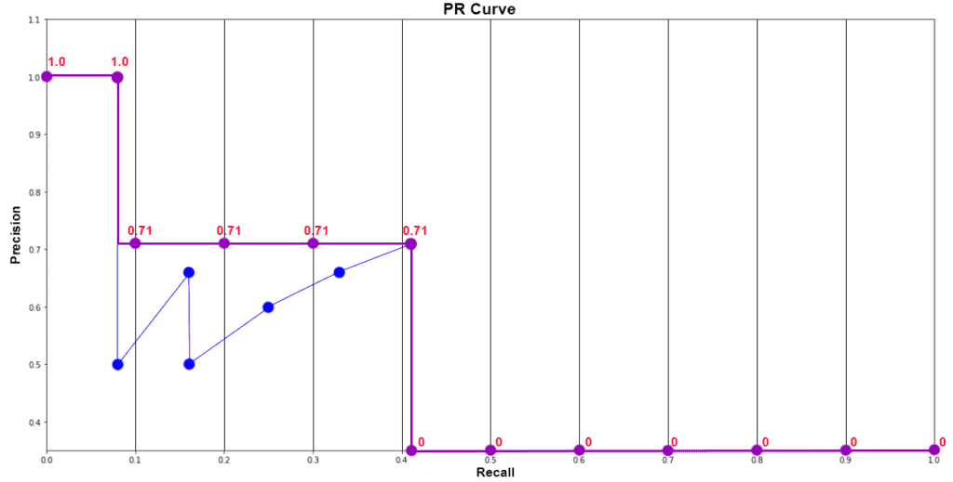
mAP: PR curve

Slide 56
mAP: mean Average Precision
If we calculated just AP for dog …… does that mean mAP is nothing but the mean of average precision calculated for each class ? Yes
As the name suggests, Mean Average Precision or mAP is the average of AP over all detected classes.
mAP = 1/n * sum(AP), where n is the number of classes.
In the example above, we have 5 classes. Therefore, the calculated mAP is;
mAP = 1/5 * (0.349 + 0.545 + 0 + 1 + 0.5) (example APs)
= 0.4788
= 47.88 %

Slide 57
What is mAP@0.50 or mAP@0.50:0.95 ?
We decided the TPs and FPs wrt the IoU values threshold at 0.5. i.e. if IoU > 0.5 then it’s a TP else it’s a FP. Therefor the mAP calculation done for IoU thresh = 0.5 is known as mAP@0.50
Similarly MS COCO defines Average Precision (AP) as mAP@[0.5:.05:.95] i.e. an average of mAPs at 0.50, 0.55,0.60…..0.95

Slide 58
Thank you
For any queries drop an email at: quadeershaikh15.8@gmail.com

